Slide 1
CPS-101 ICT Fundamentals
Lecture - 2
Lecturer Rabia Khan

Slide 2
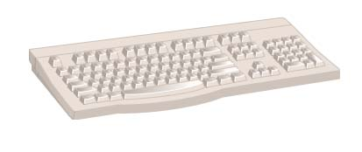
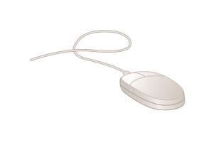
How Computers Work
All computers follow the same four basic operations
Input
Processing
Storage/Memory
Output
Keyboard
Mouse
Notes:
Input - whatever is put into (“input”) a computer system.
Input hardware - devices that allow people to put data into the computer in a form that the computer can use.
Mouse - an input device that is used to manipulate objects viewed on the computer display screen.
Keyboard - an input device that converts letters, numbers, and other characters into electrical signals readable by the processor.
FACTOID (to accompany hyperlink for Keyboard): Most keyboards were designed with a right-handed computer user in mind. However, approximately 10% of the population is left-handed. Some manufacturers produce keyboards especially for the left-handed computer user. One Web site that offers such keyboards for sale is thelefthand.com. Notice the differences in the left-hand keyboard pictured on their site. The numeric pad has been moved from its normal position on the right-hand side of the keyboard to the left-hand side. Similarly, the arrow keys along with the help, home, page up, page down, etc., keys that are normally adjacent to the numeric pad have been moved to the left-hand side of the keyboard. These two changes would allow a left-handed user to do frequent operations such as numeric data-entry and up/down, left/right movements on the screen with his or her dominant hand—the left one.
FACTOID on mouse: A computer mouse may provide one, two, three or more buttons, depending on which system software it is to be used with. Most use two buttons since that is the minimum number needed for working with the popular Microsoft Windows operating system.

Slide 3
How Computers Work
INPUT :
Input hardware - devices that allow people to put data into the computer in a form that the computer can use
Allows the user to interact
Input devices accept data
Keyboard: an input device that converts letters, numbers, and other characters into electrical signals readable by the processor
Mouse: Select options from onscreen menu
Notes:
Input - whatever is put into (“input”) a computer system.
Input hardware - devices that allow people to put data into the computer in a form that the computer can use.
Mouse - an input device that is used to manipulate objects viewed on the computer display screen.
Keyboard - an input device that converts letters, numbers, and other characters into electrical signals readable by the processor.
FACTOID (to accompany hyperlink for Keyboard): Most keyboards were designed with a right-handed computer user in mind. However, approximately 10% of the population is left-handed. Some manufacturers produce keyboards especially for the left-handed computer user. One Web site that offers such keyboards for sale is thelefthand.com. Notice the differences in the left-hand keyboard pictured on their site. The numeric pad has been moved from its normal position on the right-hand side of the keyboard to the left-hand side. Similarly, the arrow keys along with the help, home, page up, page down, etc., keys that are normally adjacent to the numeric pad have been moved to the left-hand side of the keyboard. These two changes would allow a left-handed user to do frequent operations such as numeric data-entry and up/down, left/right movements on the screen with his or her dominant hand—the left one.
FACTOID on mouse: A computer mouse may provide one, two, three or more buttons, depending on which system software it is to be used with. Most use two buttons since that is the minimum number needed for working with the popular Microsoft Windows operating system.

Slide 4
How Computers Work
Other Input devices?
  Scanners
  Microphone
  Webcam
  Digital Camera
Notes:
Input - whatever is put into (“input”) a computer system.
Input hardware - devices that allow people to put data into the computer in a form that the computer can use.
Mouse - an input device that is used to manipulate objects viewed on the computer display screen.
Keyboard - an input device that converts letters, numbers, and other characters into electrical signals readable by the processor.
FACTOID (to accompany hyperlink for Keyboard): Most keyboards were designed with a right-handed computer user in mind. However, approximately 10% of the population is left-handed. Some manufacturers produce keyboards especially for the left-handed computer user. One Web site that offers such keyboards for sale is thelefthand.com. Notice the differences in the left-hand keyboard pictured on their site. The numeric pad has been moved from its normal position on the right-hand side of the keyboard to the left-hand side. Similarly, the arrow keys along with the help, home, page up, page down, etc., keys that are normally adjacent to the numeric pad have been moved to the left-hand side of the keyboard. These two changes would allow a left-handed user to do frequent operations such as numeric data-entry and up/down, left/right movements on the screen with his or her dominant hand—the left one.
FACTOID on mouse: A computer mouse may provide one, two, three or more buttons, depending on which system software it is to be used with. Most use two buttons since that is the minimum number needed for working with the popular Microsoft Windows operating system.

Slide 5
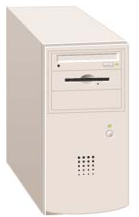
How Computers Work
Input
Processing
Storage/Memory
Output
Case or system cabinet
Notes:
Processing - the manipulation a computer does to transform data into information.
Case or system cabinet - the box that houses the processor chip (CPU), the memory chips, and the motherboard with power supply, as well as some secondary storage devices.
FACTOID: The popular iMac microcomputer manufactured by Apple Computer does not have a case separate from its monitor. Instead, the monitor, CPU, memory chips, motherboard, power supply, hard-disk drive and CD or CD/DVD drive are all contained in one compact unit.

Slide 6
How Computers Work
Processing devices
  Brains of the computer
  Carries out instructions from the program
  Manipulate the data
  Most computers have several processors
  Central Processing Unit (CPU)
  Secondary processors
  Processors made of silicon and copper

Slide 7
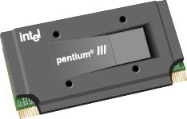
How Computers Work
Processor chip - A tiny piece of silicon that contains millions of miniature electronic circuits.
Processor chip
Notes:
Processor chip - A tiny piece of silicon that contains millions of miniature electronic circuits.

Slide 8
How Computers Work
Primary storage (memory) - RAM
Computer circuitry that temporarily holds data waiting to be processed
Secondary storage (storage) – ROM
The area in the computer where data or information is held permanently
Input
Processing
Storage/Memory
Output

Slide 9
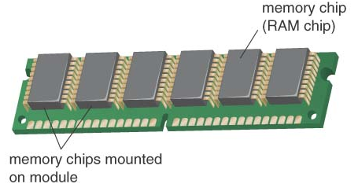
How Computers Work
Random Access Memory
Also known as RAM or memory
Represent primary storage or temporary storage.
Hold data before processing and information after processing.
Volatile
More RAM results in a faster system
In Mega/Giga Bytes
RAM
Notes:
Memory chips:
Also known as RAM (Random Access Memory).
Represent primary storage or temporary storage.
Hold data before processing and information after processing.

Slide 10
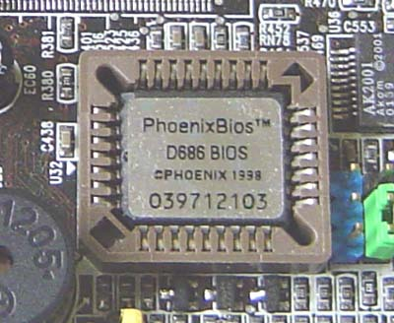
How Computers Work
Read Only Memory
Also called ROM
Permanent storage of programs
Holds the computer boot directions
Typically in KiloBytes
ROM
Notes:
Memory chips:
Also known as RAM (Random Access Memory).
Represent primary storage or temporary storage.
Hold data before processing and information after processing.

Slide 11
How Computers Work
Storage devices
  Hold data and programs permanently
  Different from RAM
  Magnetic storage
    Floppy and hard drive
    Uses a magnet to access data
  Optical storage
    CD and DVD drives, Blue-Ray
    Uses a laser to access data
1B-<number>

Slide 12


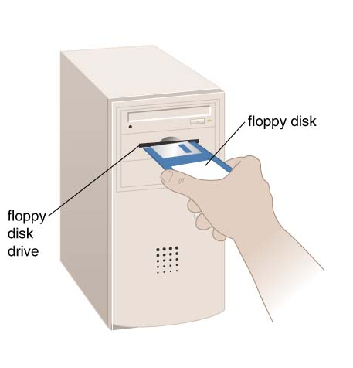
How Computers Work
Floppy-disk drive
  stores data on removable 3.5-inch-diameter diskettes.
  Typical Capacity 1.4MB
Zip-disk drive
  stores data on floppy-disk cartridges with 70-170 times the capacity of the standard floppy.
Floppy disk
Zip disk
Notes:
Floppy-disk drive - a storage device that stores data on removable 3.5-inch-diameter diskettes.
Zip-disk drive - a storage device that stores data on floppy-disk cartridges with 70-170 times the capacity of the standard floppy.

Slide 13
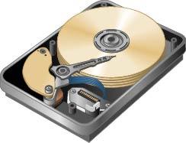
How Computers Work
Hard-disk drive
a storage device that stores billions of characters of data on a non-removable disk platter.
Capacity 40GB-320GB or even more
Hard-disk drive

Slide 14
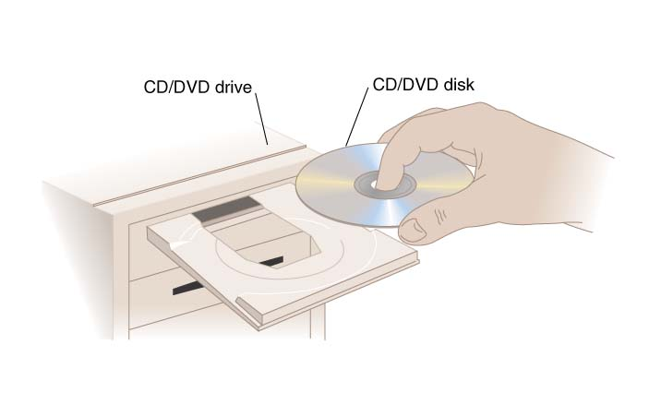
How Computers Work
CD (Compact Disk) drive or DVD (Digital Video Disk) drive
  a storage device that uses laser technology to read data from optical disks.
  700MB for CD
  1.4 to 17 GB for DVD
Blue Ray
  optical disc storage
  high-definition video and data storage.
  same physical dimensions as standard DVDs and CDs.
  Currently Upto 50GB capacity
CD Drive
Notes:
CD (Compact Disk) drive or DVD (Digital Video Disk) drive - a storage device that uses laser technology to read data from optical disks.

Slide 15
How Computers Work
Input
Processing
Storage
Output
Output hardware
devices which translate info processed by the computer into a form that humans can understand
Notes:
Output hardware - devices which translate info processed by the computer into a form that humans can understand.
Peripheral device - any component or piece of equipment that expands a computer’s input, storage, and output capabilities.
Sound card - enhances the computer’s sound-generating capabilities by allowing sound to be output through speakers.

Slide 16
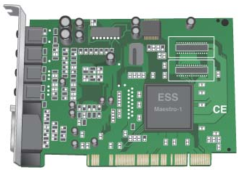
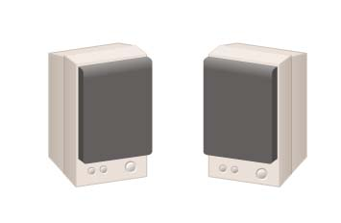
How Computers Work
Sound Card
Coverts audio signal from digital to analog and vice versa
Both Input and Output device
Speakers
the devices that play sounds transmitted as electrical signals from the sound card.
Sound card
Speakers
Notes:
Output hardware - devices which translate info processed by the computer into a form that humans can understand.
Peripheral device - any component or piece of equipment that expands a computer’s input, storage, and output capabilities.
Sound card - enhances the computer’s sound-generating capabilities by allowing sound to be output through speakers.

Slide 17
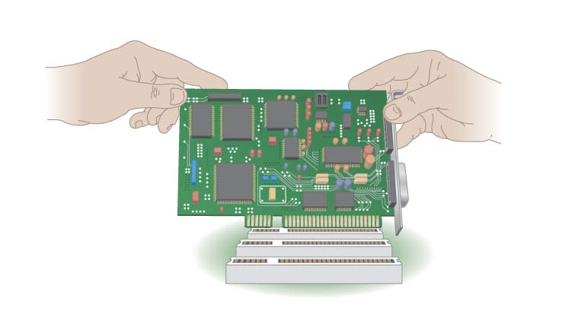
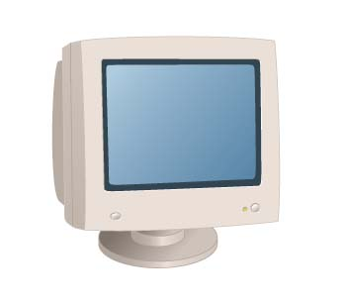
How Computers Work
Video card
converts the processor’s output information into a video signal that can be sent through a cable to the monitor
Monitor
the display device that takes the electrical signals from the video card and forms an image using points of colored light on the screen
Video card
Monitor

Slide 18
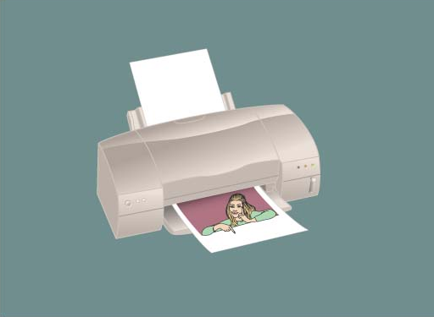
How Computers Work
Input
Processing
Storage
Output
Printer - an output device that produces text and graphics on paper.

Slide 19
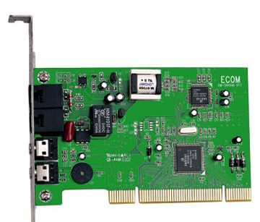
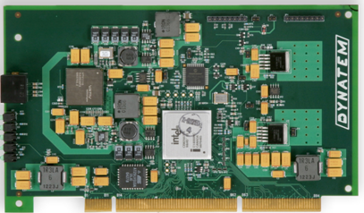
How Computers Communicate
Modem - a device that sends and receives data over telephone lines to and from computers.
NIC – Controls the flow of data on a network link
Modem
Network Interface Card
Notes:
Modem - a device that sends and receives data over telephone lines to and from computers.

Slide 20
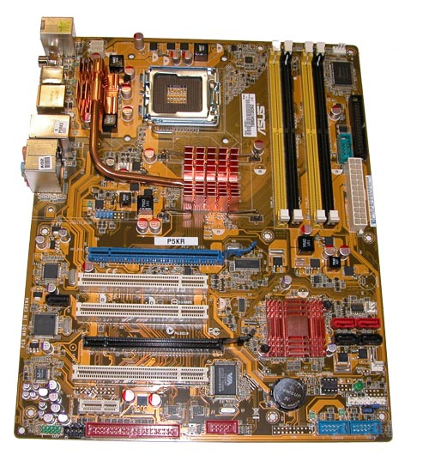
How Does Everything Connect?
Motherboard
  the main printed circuit board in the computer
  Everything connects to the motherboard
  Expansion slots - “plugs” on the motherboard for expanding the PC’s capabilities via additional circuit boards

Slide 21
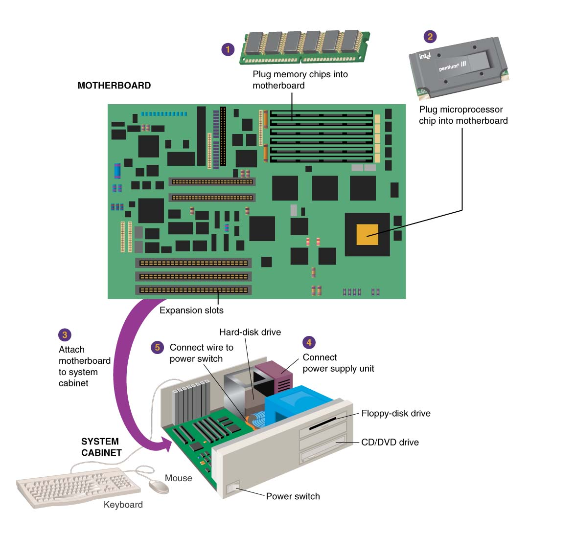
How Does Everything Connect?
Motherboard
Notes:
Motherboard - the main circuit board in the computer.
Everything else attaches to the motherboard through connections called ports.
.

Slide 22
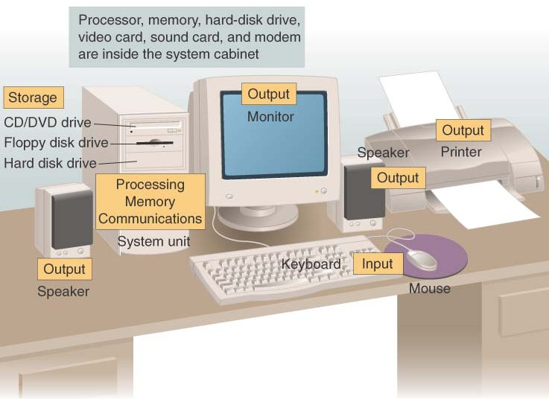
Put all the hardware together and…

Slide 23
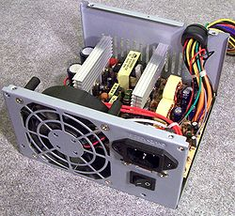
Put all the hardware together and…
What is Left?
Power
  Inside system cabinet

Slide 24
Concept Check
What are the five basic operations that computers have in common?
Input, processing, storage, output, and communications

Slide 25
Concept Check
Which type of storage is composed of computer circuitry that temporarily holds data waiting to be processed?
Primary storage (memory)

Slide 26
Concept Check
What computer device consists of electronic circuitry that executes instructions to process data?
CPU (Central Processing Unit)

Slide 27
Concept Check
What is the name of the main circuit board in the computer, to which everything else is attached via connections called ports?
Motherboard

Slide 28
Concept Check
How many characters can be represented by a byte? A kilobyte?
One character in a byte; 1024 in a kilobyte

